Slide 1
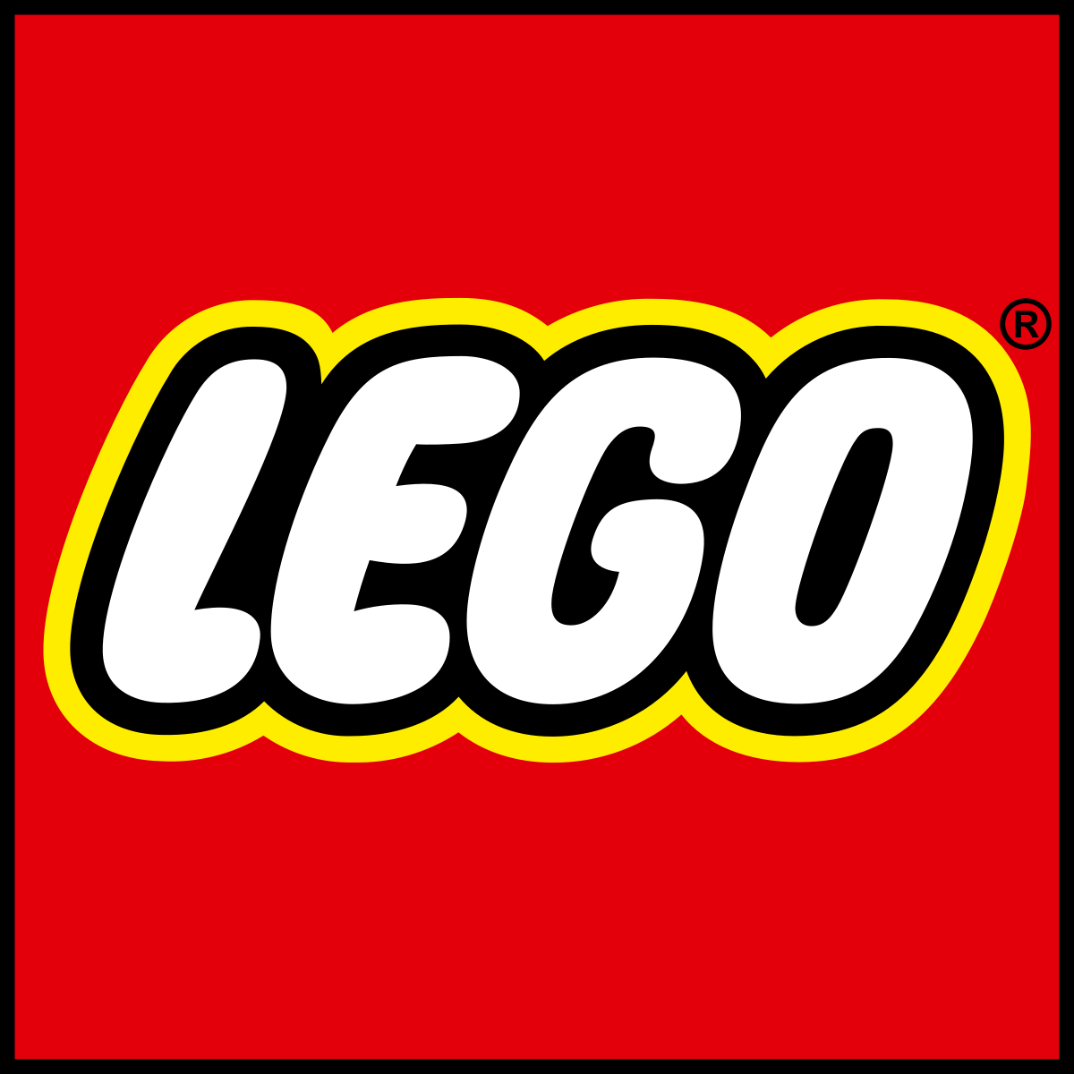
Critical analysis of
Ten Types of Innovation

Slide 2


Team Introduction:
Sean Khuon
Vikas Sanil Sanil
Undergraduate - ITM Bachelors
Graduate Student - ITM

Slide 3
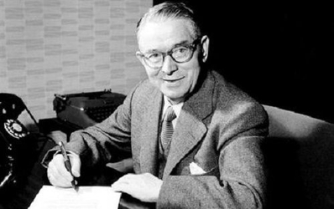
What is LEGO?
LEGO is a Danish based toy company that specializes in manufacturing plastic construction toys known for their brick like appearance. LEGO is derived from the Danish phrase leg godt which translates to play well. Over the years they have branched out into various medias, mostly pop culture related such as video games, movies, amusement parks, even official collaborations with famous architects and vehicle models.
LEGO bricks fit together through friction and the design is called “clutch power”. It was patented in Copenhagen on January 28, 1958.
LEGO’s founder and creator Ole Kirk Kristiansen

Slide 4
Profit Model
All LEGO products follow same basic design such that any new product doesn’t require more than 20 new additional bricks to be manufactured. Currently LEGO manufactures 70000 unique bricks and they have maintained this number every year.
LEGO retains only best selling products after a year of launch. This ensure they are manufacturing products which will be sold in a retail store and doesn’t add up as inventory of unsold items.
LEGO ensures its dominance in the toy market by providing unique user experience and larger presence in media so that they are synonym for the type of toys they manufacture. LEGO safeguards its copyright and design very ferociously. It keeps monitoring every market they are in and go after copycats, big or small.

Slide 5
Profit Model - Where it went wrong?
Around 1990s, LEGO set up design labs around the world and let the designers design whatever they felt like in silos. This introduced lot of new bricks into the system and where not reverse compatible with existing bricks. At one point LEGO was manufacturing 120000 unique bricks, which increased their manufacturing cost.
For a long time LEGO maintained itself as creative toy for children and didn’t collaborate itself with any pop cultures from other media. The collaboration with StarWars introduced them to other pop culture avenues where they can make profit.

Slide 6
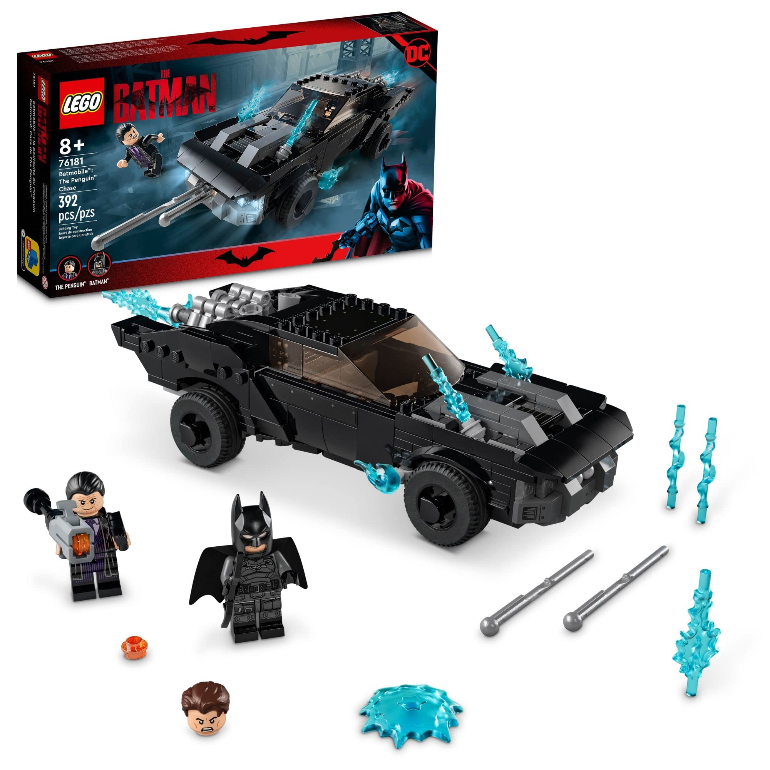
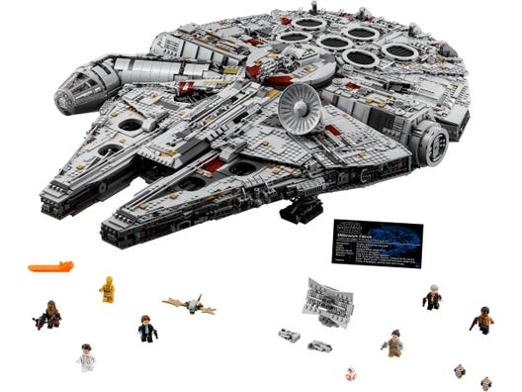


Network
LEGO has worked with various companies and media franchises to make various pop culture kits. Star Wars and DC Comics come to mind as LEGO’s top collaborations. Car and motorcycle companies have also been licensed such as Porsche and Ducati.

Slide 7
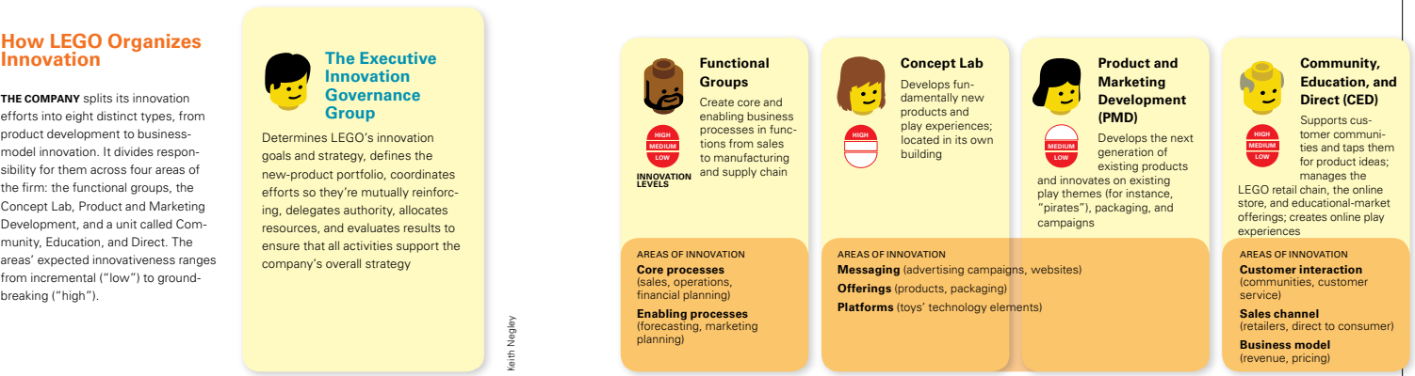
Structure

Slide 8
Structure - Where it went wrong
LEGO went wrong twice in its structure innovation:
Till 1990s, LEGO main office Billund in Denmark controlled all the decision making power and this caused bottle neck as they grew globally.
When they opened up this bottle neck by creating local decision making centers they missed to set a unique company philosophy to guide decision making process. This caused lot of disagreements within the organization as new directions taken by local bodies followed their only beliefs or philosophy.
LEGO introduced voting system within the organization to resolve the conflicts and established core philosophy to be followed while making new design or decisions.

Slide 9
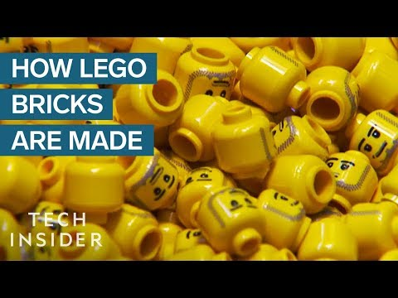
Process

Slide 10
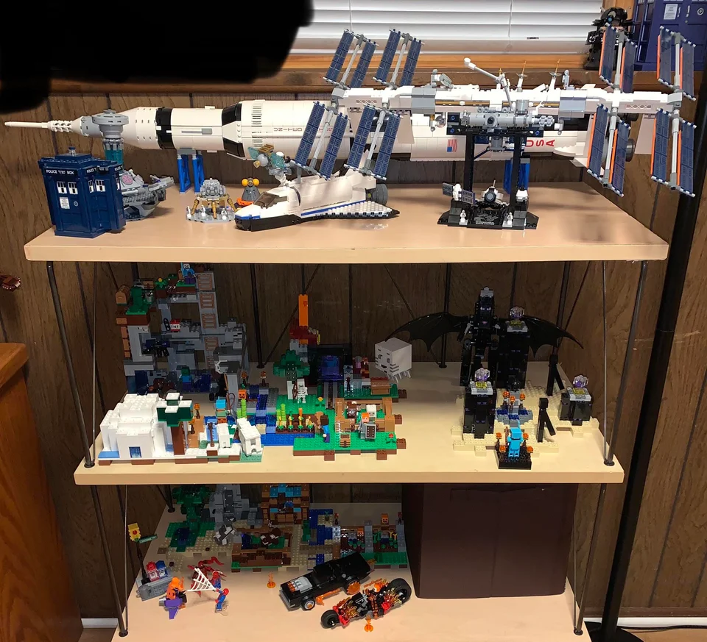
Product Performance - Interlocking Brick and Studs Technology
This is how LEGO is able to create so many complementary kits. It is said that when LEGO designs a new piece, it has to be compatible with every LEGO piece ever made. This technology is what allows LEGO to be super versatile.
Credit: u/J03-K1NG/

Slide 11
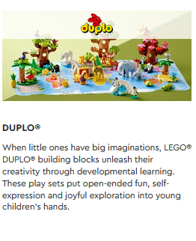
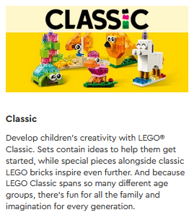
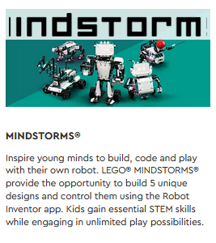
Product System
Initial LEGO toys were for children in school and was a great success, which is now named “Classic”.
LEGO expanded its offering to pre-school kids with DUPLO, which is relatively smaller in size to Classic. And it is compatible with Classic, so that kids can still use it when they transition into Classic.
LEGO has ensured every new theme they have introduced is compatible with existing themes so that customers can use them interchangeably.
Over the years LEGO has grown with its customers and changing culture to accommodate all age group using same interlocking system.
Following link has all themes LEGo has introduced over the years. https://en.brickimedia.org/wiki/List_of_themes

Slide 12
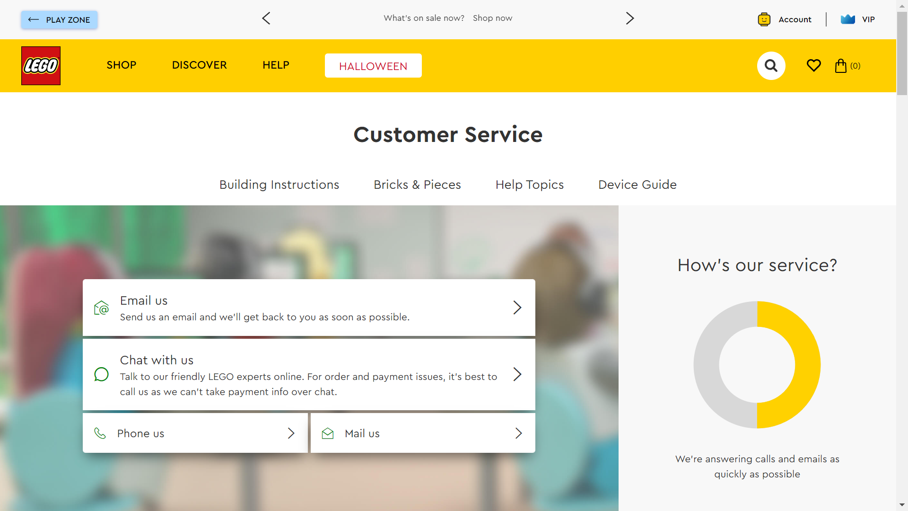
Service
LEGO also has their own support service for help with kits, orders, and any inquiries users may have as a LEGO customer. LEGO takes constant feedback from its retail sellers to understand the changing markets and keeps only it’s best sellers in production along with new products for that year.

Slide 13
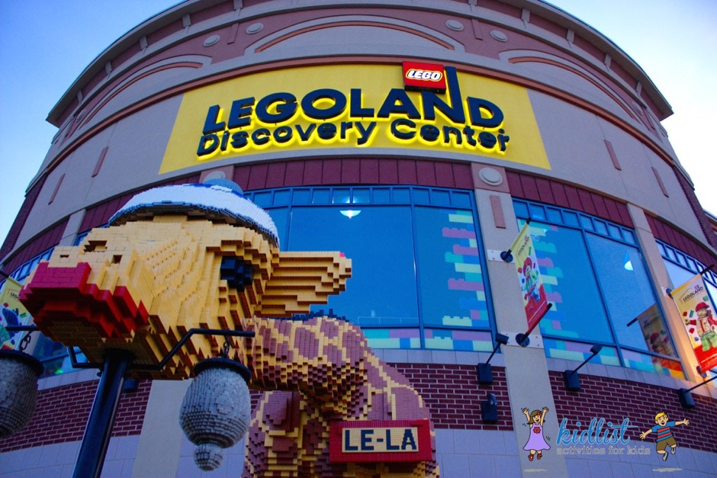
Channel
LEGO distributes their product in many forms. You can buy LEGO products in person at many retailers such as Walmart and Target, online such as Amazon
Some LEGO products are digital such as their various forms of media like TV Shows and video games.
Lastly LEGO distributes themselves as an experience, most notably with LEGOLAND.

Slide 14
Brand
LEGO is the quintessential “Interlocking Brick” toy, that is their brand and the LEGO group has fought hard to protect it, filing many patents and lawsuits to maintain their brand image. However, LEGO’s patent on the bricks themselves have expired and a ruling in 2005 in the Supreme Court of Canada allowed their competitor Mega to continue selling their interpretation of the plastic interlocking brick system toy.

Slide 15
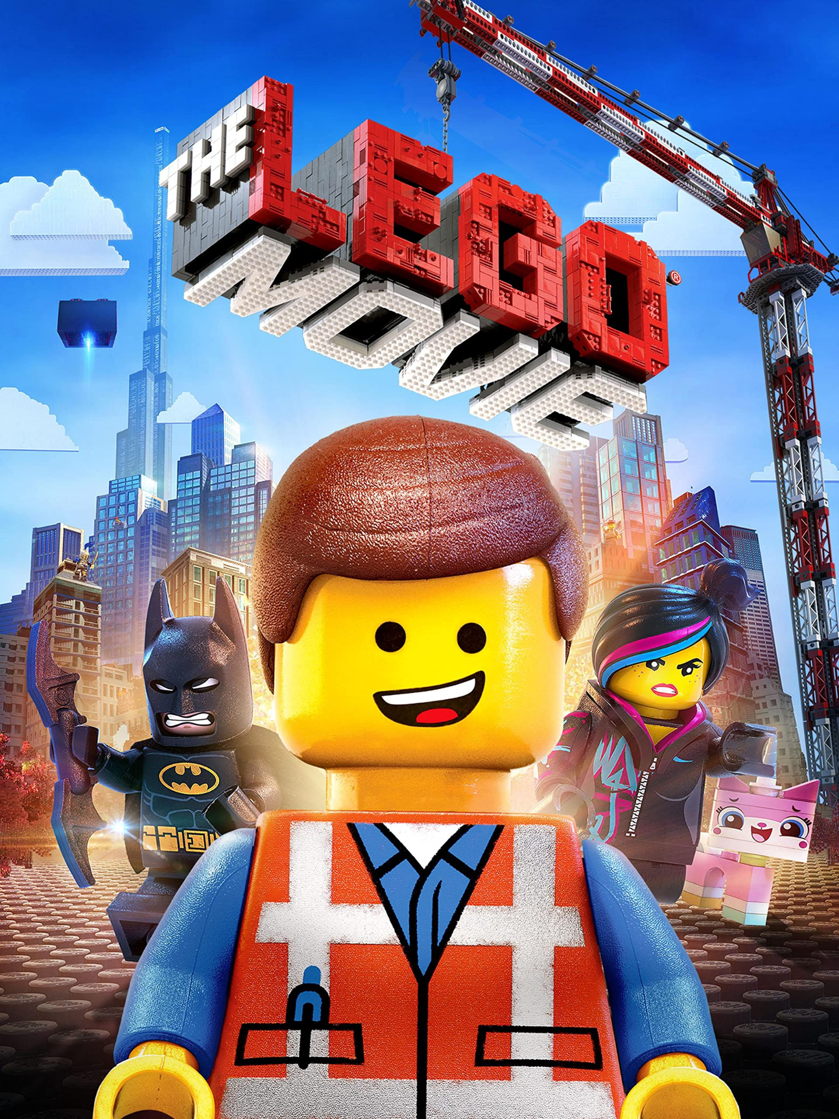
Brand - Cont.
LEGO has maintained their pop culture and staying power.
LEGO’s licenses with Star Wars as well The LEGO Movie establishing LEGO as a movie franchise and merchandising opportunity helped LEGO’s brand stay in power.

Slide 16
Customer Engagement
Over the years the LEGO group has interacted with their customer base directly which has led to mostly better customer relations and advancement for the LEGO group.
LEGO shops are not evaluated based on sales, its evaluated based on customer product experience. Customer can walk into LEGO shop and play with any brick set they are interested in and walk out without buying it. The “Brick Experts” in the store will help customers in any question related to the different LEGO themes.

Slide 17
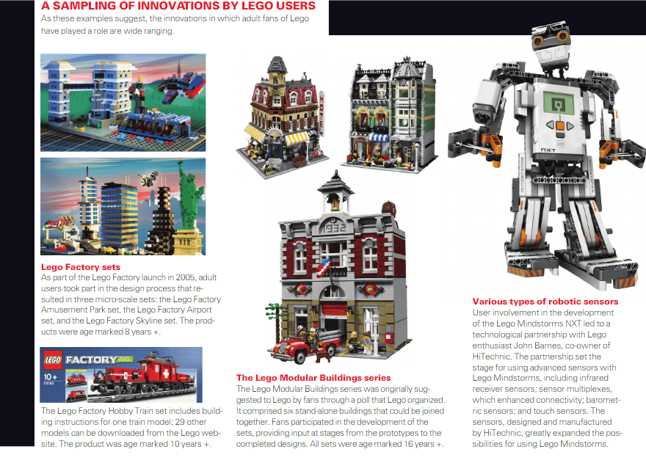
Customer Engagement - User Innovation

Slide 18
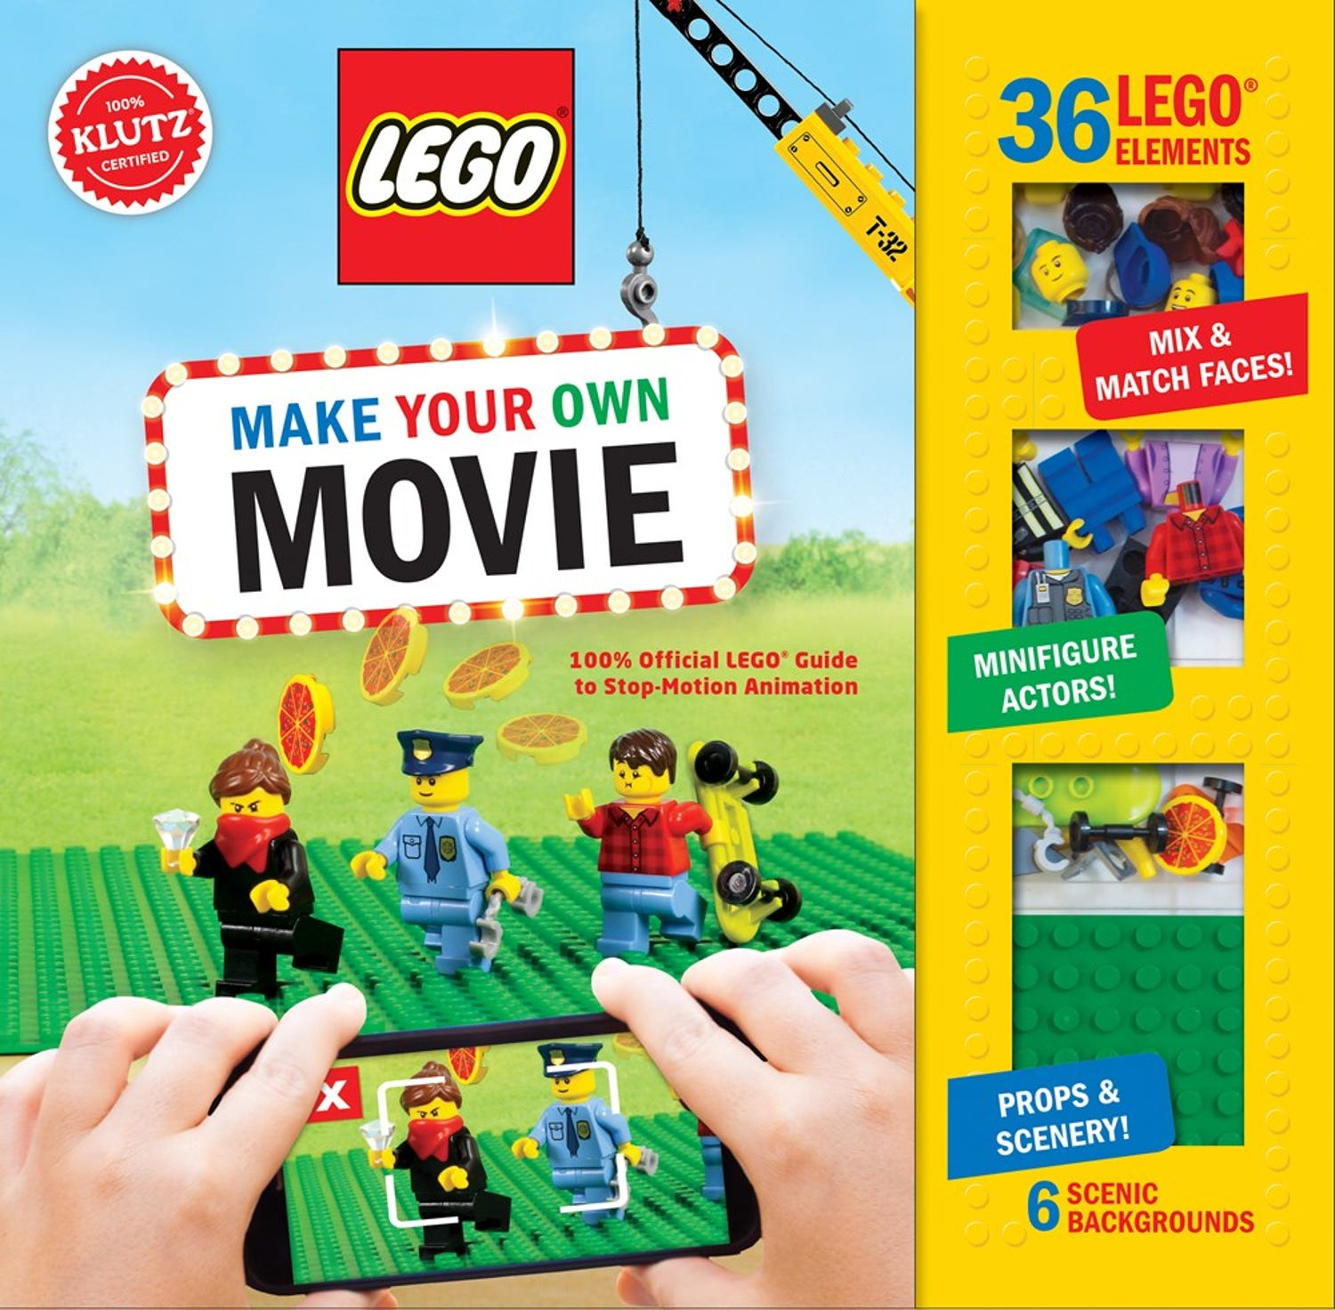
Customer Engagement - Stop Motion
There is a whole fanbase dedicated to stop motion animation using LEGO as the medium.
LEGO has embraced this fanbase with their own official guide book LEGO: Make Your Own Movie to encourage users to use LEGO.
The LEGO Movie itself has its animation style derived from the countless Stop Motion pieces made by fans.

Slide 19
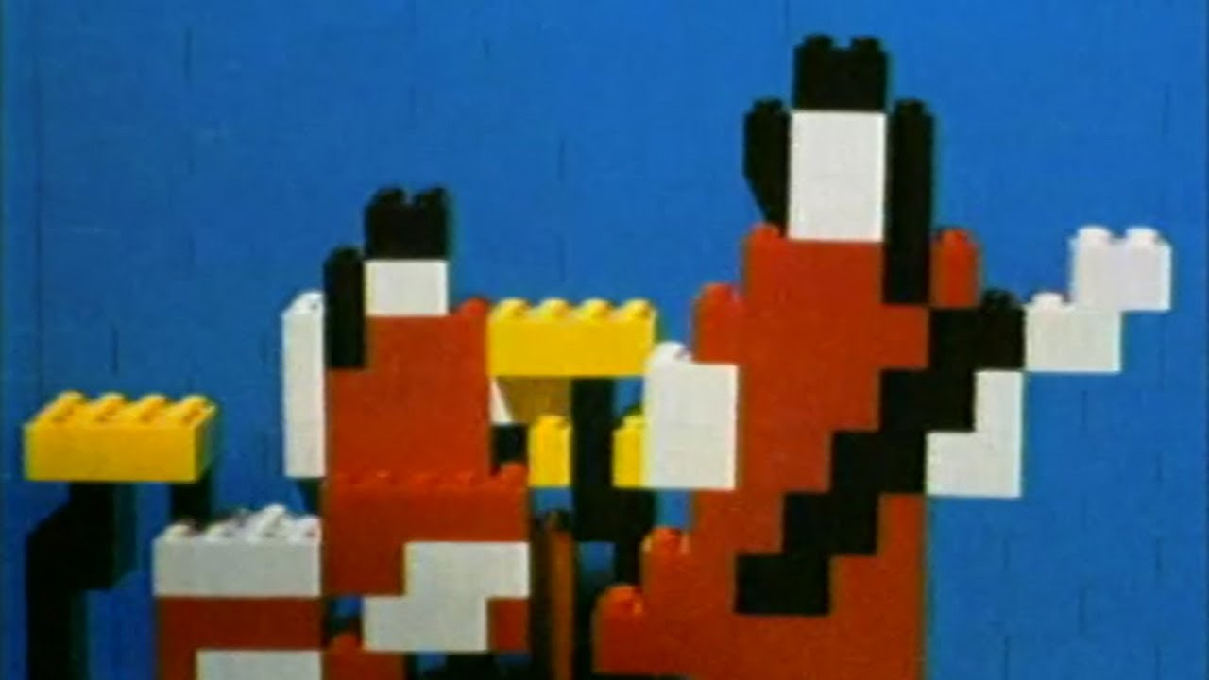
Customer Engagement - Where it Went Wrong
The White Stripes’s music video for their song “Fell in Love With a Girl” is famous for its use of LEGO as its stop motion medium. When the music video wrapped up production The White Stripes reached out to LEGO in hopes of having an official collaboration. LEGO turned them down as they stated they did not market to a demographic of those over 12 years of age. However, when the music video gained popularity, LEGO suddenly reached out again and this time The White Stripes turned them down stating that they “had their chance”.
Still from the animated music video

Slide 20
Conclusion
Over the years, LEGO has mastered on the ten types of innovation and turned itself from a toymaker’s small operation into a pop culture toy giant.
They also provide insight into how an innovation can go wrong as they have failed implementing few of these innovations in first go.
LEGO are here to stay with the various constant innovation in their networks, products, and channels. And also with loyal user base..

Slide 21

Questions?

Slide 22
Sources
LEGO. (n.d.). LEGO® Duplo®. LEGO® DUPLO® - LEGO® History - LEGO.com US. Retrieved October 11, 2022, from https://www.lego.com/en-us/history/articles/e-lego-duplo/
Franscisco, . (2016, February 26). Difference Between LEGO and Mega Blocks. Difference Between Similar Terms and Objects. http://www.differencebetween.net/miscellaneous/sports-miscellaneous/difference-between-lego-and-mega-blocks/.
Wilson, T. V. (2006, June 28). How lego bricks work. HowStuffWorks. Retrieved October 11, 2022, from https://entertainment.howstuffworks.com/lego1.htm
Antorini, Y. M., Muñiz, A. M., &amp; Askildsen, T. (2012). Collaborating with customer communities: Lessons from the Lego Group. When Innovation Moves at Digital Speed, 53(3), 73–79. https://doi.org/10.7551/mitpress/11858.003.0007
Beemlaw. (2017, November 15). Billion Dollar lego patent. Beem Patent Law. Retrieved October 11, 2022, from https://beemlaw.com/billion-dollar-lego-patent/#:~:text=Fifty%2Deight%20years%20ago%20today,year%20term%20ended%20in%201978.
Youtube. (2006). White Stripes - Fell in Love With a Girl (making). Youtube. Retrieved October 10, 2022, from https://www.youtube.com/watch?v=JzebYFxuB-A.
David C. Robertson, Brick by Brick: How LEGO rewrote the rules of Innovation and Conquered the global toy industry

